Slide 1
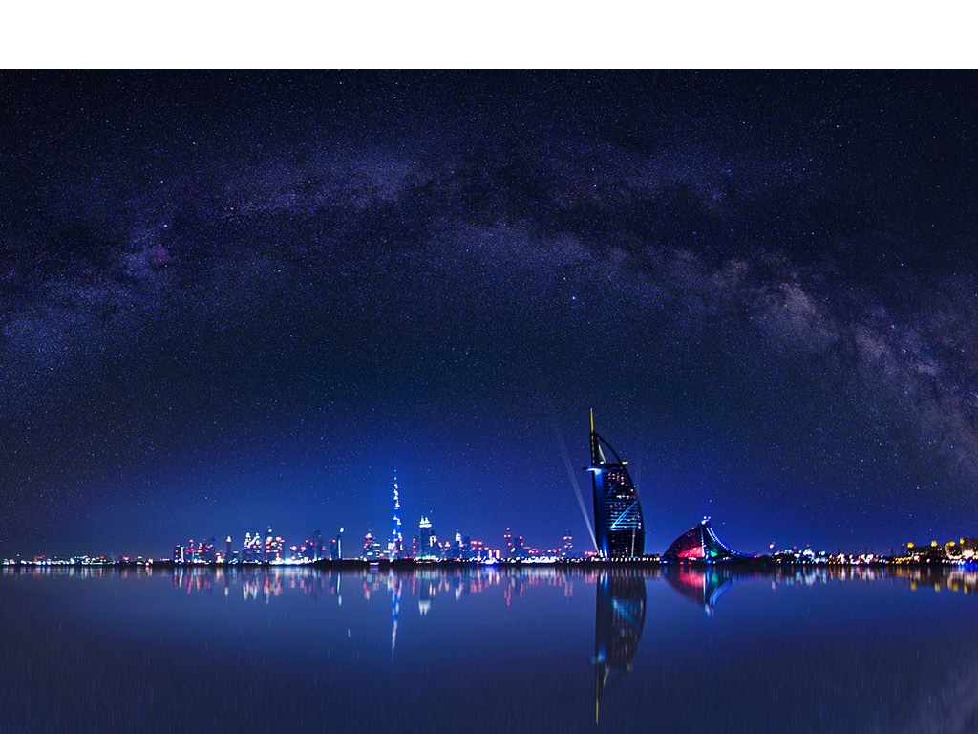
WHY DUBAI
Your Partners in Success, Growth & Expansion

Slide 2
ABOUT
DUBAI FDI
Dubai Investment Development Agency (DUBAI FDI),
is an agency of the Dubai Economy (formerly called the Department of Economic Development (DED)) – Government of Dubai.
We develop, promote and support Foreign Direct Investment (FDI) opportunities to facilitate investors’ success, growth and expansion in Dubai, the United Arab Emirates and across regional and international markets.

Slide 3
ABOUT
DUBAI FDI
Our Vision
To Make Dubai the Leading Global Foreign Direct Investment Destination
Our Mission
To Sustain and Grow Foreign Direct Investment Inflows to Dubai

Slide 4
ABOUT
OUR SERVICES
Support during initial set-up and after care services
Connectivity to other government departments
Provide market visibility through research and studies
Advisory and advocacy for policy change to improve the
investment environment

Slide 5
WHY DUBAI
LOCATION
Dubai
occupies a
unique location
in the world
8
2.4
HOUR FLIGHT
8
connects 2/3 of
BN PEOPLE
the world’s people
with Dubai
size of the market
HOUR FLIGHT
served within five
connects 2/3 of
hours of Dubai
the world’s population
2015
with Dubai

Slide 6
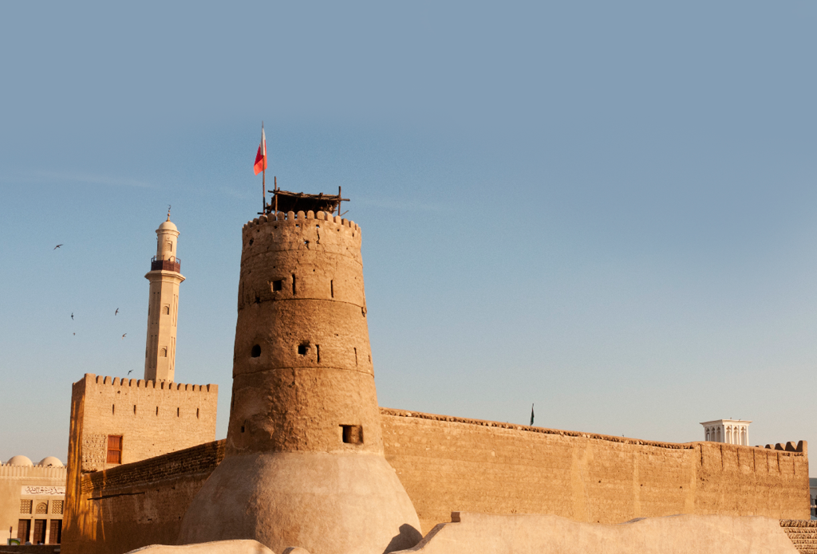
WHY DUBAI
HISTORY AND CULTURE
1833
1985
800 members of
Dubai became
the Bani Yas tribe,
1950s
a business and
led by the Maktoum
tourism hub
family, settled at the
mouth of the creek
Dubai emerges
as a major trade
and export hub
202
1966
Nationalities living
in harmony
Revenues from
oil discovery used
Strong
to strengthen city
government
infrastructure
focus on
HAPPINESS

Slide 7
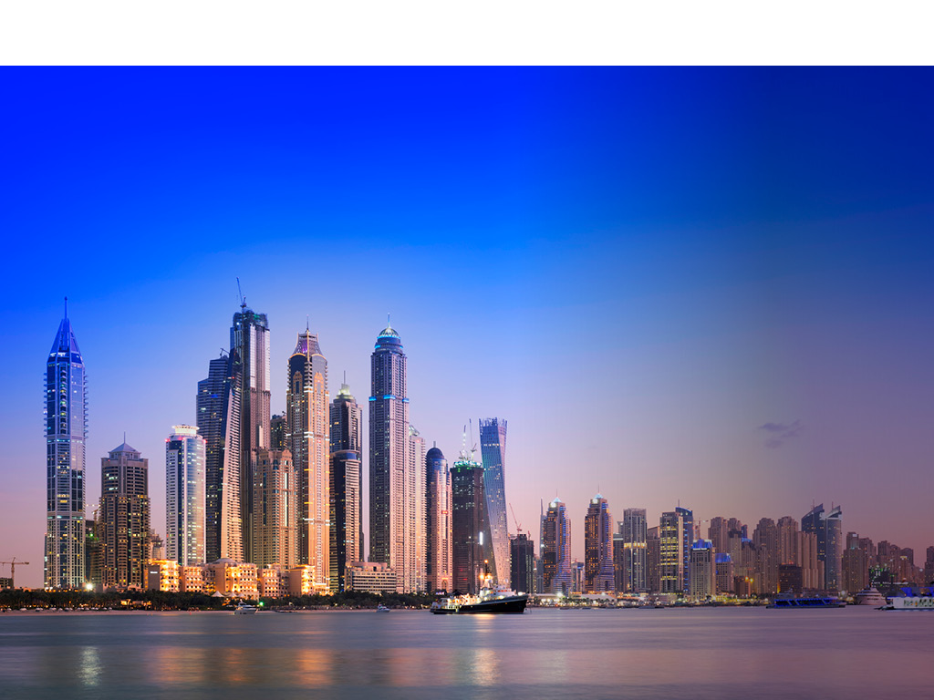
WHY DUBAI
ECONOMIC DIVERSITY
Dubai has a
53%
highly diversified
economy
of GDP
from Trade,
Logistics and
Tourism
4%
88.7%
between
2013 and 2015
GDP growth
of GDP
in 2015
is from
non-financial
corporations
H1,2016

Slide 8
WHY DUBAI
ECONOMIC DIVERSITY
DUBAI GDP CONTRIBUTION
4.1%
11.4%
Other
Manufacturing
12.6%
164
7.4%
Financial
Corporations Sector
Construction
M
METRO PASSENGERS
15.6%
108.9m taxi passengers
28.3%
Real Estate and
531M
91.9m public buses
Business Services
Trade
passengers
14% share of public
PUBLIC TRANSPORT
transport in people’s
PASSENGERS in 2014
mobility
14.9%
compared to 440m in
5.7%
2015
Logistics and
2013 (21% increase)
Transportation
Hospitality
2014

Slide 9
WHY DUBAI
INFRASTRUCTURE
$4.66 BN
74.6 KM
Dubai’s
infrastructure
is new, modern
RTA’s project pipeline
Longest driverless metro
and growing all
value in 2014
in the world, with 421km
the time
planned for 2030
3rd
attractive investment destination for infrastructure investors
543.6M
PUBLIC TRANSPORT
PASSENGERS in 2016
0.75% increase from
2015
2017

Slide 10
WHY DUBAI
INFRASTRUCTURE
PUBLIC TRANSPORT SERVICES
IN DUBAI (2016)
191M
181M
152M
164
METRO
TAXI
PUBLIC BUS
M
PASSENGERS
PASSENGERS
PASSENGERS
METRO PASSENGERS
108.9m taxi passengers
91.9m public buses
531M
passengers
14% share of public
PUBLIC TRANSPORT
transport in people’s
24%
PASSENGERS in 2014
mobility
compared to 440m in
2015
2013 (21% increase)
SHARE OF PUBLIC TRANSPORT IN PEOPLE’S MOBILITY
2014

Slide 11
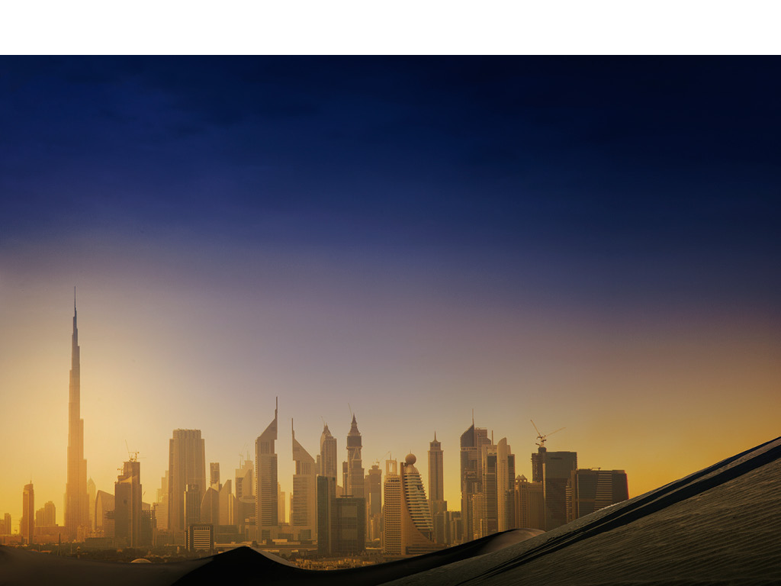
WHY DUBAI
RANKINGS OF THE YEAR
INFLUENTIAL
CONNECTED
Dubai ranked 7th
Dubai ranked
most influential
first for airport
city of Forbes
connectivity to
NUMBER ONE
2015
business districts
Dubai tops Mercer’s Quality of living index across cities in the Middle East and Africa 2016
FIRST IN FDI
by PWC
STRATEGY
2014
Dubai tops
ranking by FDI
Magazine, in
COMPETITIVE
a ranking of
WEF names the
130 global FDI
UAE 16th most
locations
competitive nation
DESTINATION CITY
globally for
2015
Dubai fourth
on MasterCard
2016-2017
Global Destination
2016
Cities Index
2016

Slide 12
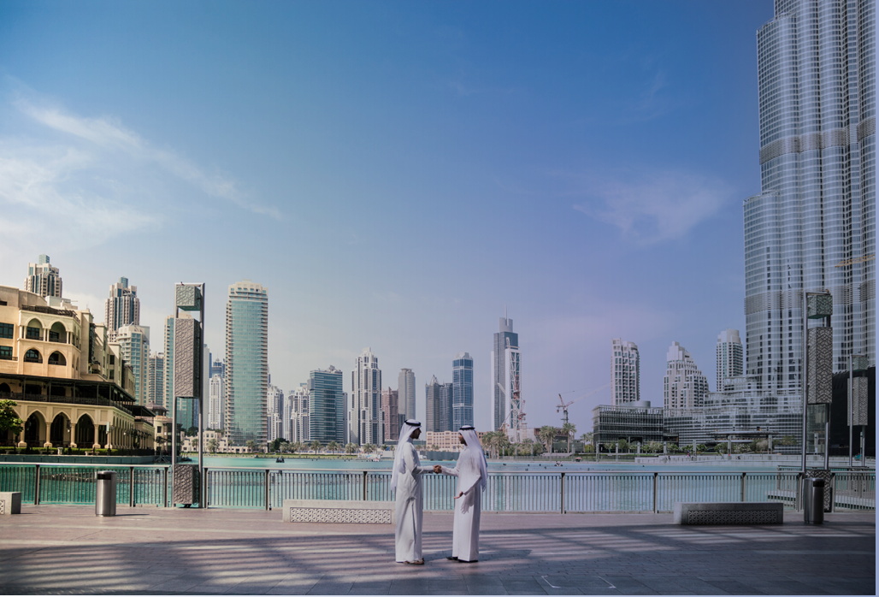
FORWARD
DUBAI PLAN 2021
DUBAI PLAN 2021
Educated, healthy
Proactive,
innovative and
happy individuals
transparent, reliable
and innovative
A smart,
government
sustainable and
healthy living
environment
A vibrant, tolerant
Pro-business
and inclusive
preferred
multicultural
investment
society
destination
offering
sustainable
economic
A secure, cultural
growth
and entertaining
place to live

Slide 13
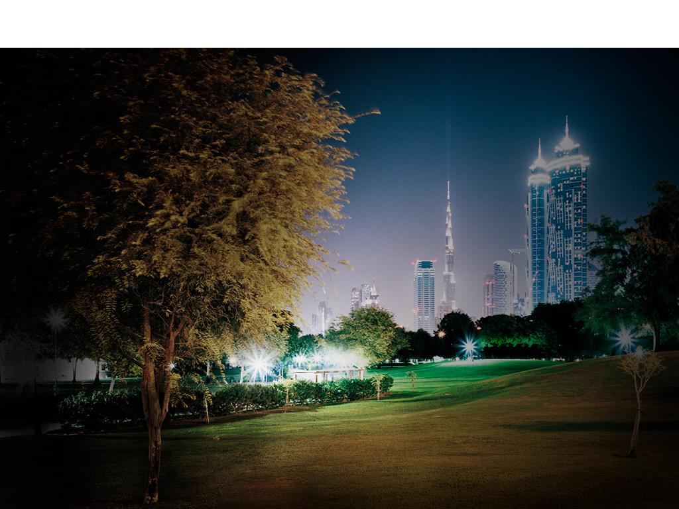
FORWARD
GREEN TECHNOLOGY
Dubai is taking a
SHAMS DUBAI
DEWA first in region
regional leadership
to introduce net-
position in the development
metering for solar
of a green economy
power generation
$13.7
BN
to be invested in
5000MW Mohammed
bin Rashid Al Maktoum
solar plant by 2030
$27.4
BN
$136.9
DUBAI GREEN FUND
M
To support and
to be invested in clean
finance clean energy
energy R&D labs by 2020
projects by 2020

Slide 14
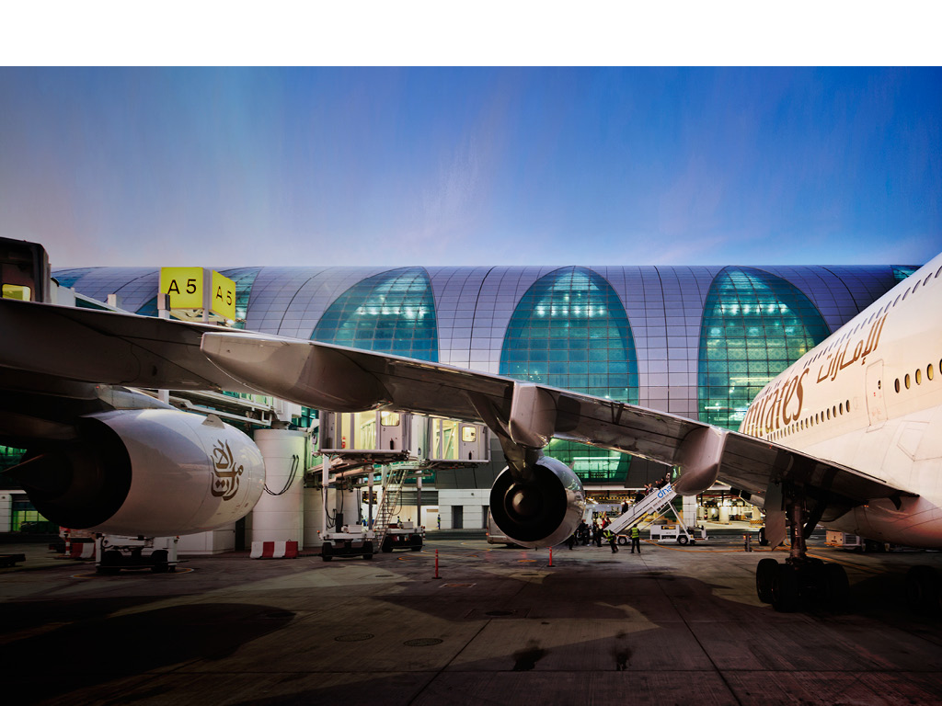
FORWARD
GREEN TECHNOLOGY
6,500
71.3M
^{Dubai International}
WEEKLY FLIGHTS
DUBAI CLEAN ENERGY STRATEGY 2050
^{awarded airport of}
by over 140
PASSENGERS IN
^{the year in 2015}
airlines directly
2014
connecting Dubai
expected to exceed
^{(Aviation Business Awards)}
DUBAI’S RENEWABLE ENERGY TARGET
to 260 destinations
126M in 2020
and 200M in 2030
7%
25%
75%
2020
2030
2050
3.1M TONNES
^{Airfreight moved}
^{through DXB and}
DWC in 2014
CURRENT ECONOMY
GREEN ECONOMY

Slide 15
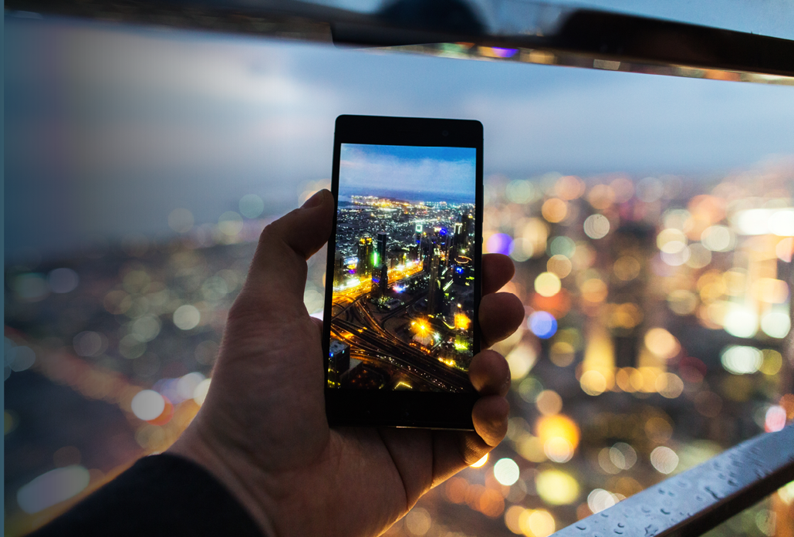
FORWARD
SMART CITY
Initiatives
To make Dubai
launched include:
the happiest
city on earth
Happiness meter
SMART DUBAI
Launched
INDEX- first ever
in 2014 with
performance
100 initiatives
indicator tool
Open data law
1000
Government services
will go smart in 2017

Slide 16
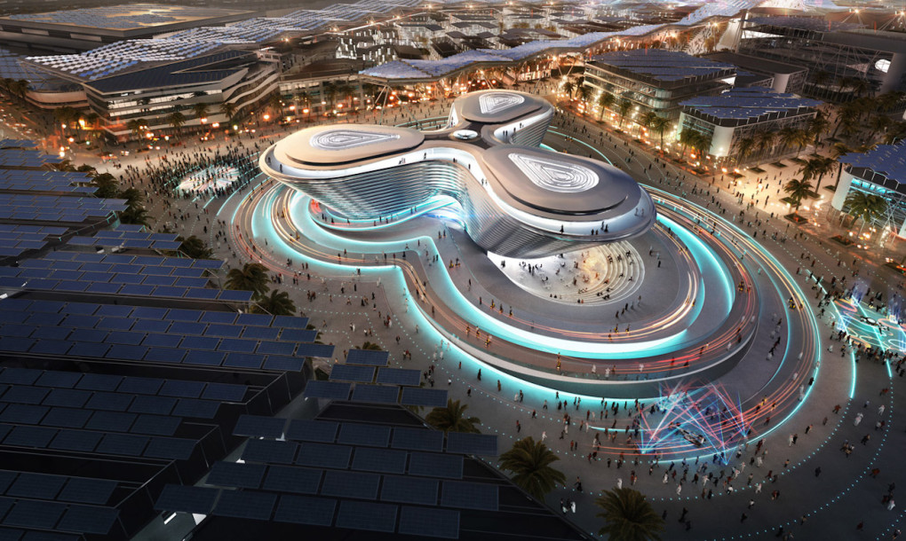
FORWARD
DUBAI EXPO 2020
EXPO 2020 DUBAI
THEME
20 October 2020
‘Connecting Minds
through 10 April 2021
Creating the Future’
SUB-THEMES
Mobility
Sustainability
FIRST TIME
Opportunity
World Expo to
be staged in
MEASA region
25
M
Visits expected to
the event, 70% to
be international

Slide 17
FORWARD
FEDERAL SCIENCE,TECHNOLOGY AND INNOVATION POLICY
TARGETING 40% INCREASE IN
KNOWLEDGE WORKERS BY 2021
$1.6BN
$8.5BN
Innovation incubators
R&D in
Priority sector
Tax-free: no income tax,
$82BN
$5.5BN
$11BN
100% foreign ownership
Space sector
Aviation R&D
investment
and manufacturing
100% repatriation of profits
22 sector specific freezones
$20BN
$1.6BN
Renewable
Academic
energy
research centers
$34BN
Clean energy
projects

Slide 18
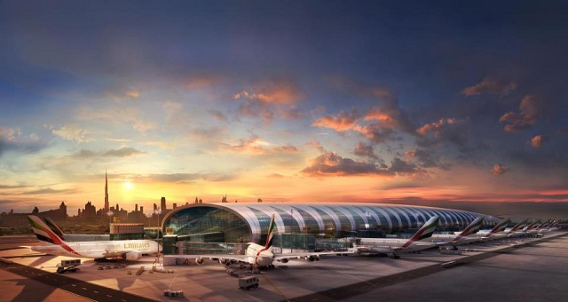
OPPORTUNITIES
AVIATION AND CONNECTIVITY
3.49M TONNES
6,500
^{Airfreight moved}
WEEKLY FLIGHTS
^{through DXB and}
through Dubai Airports
DWC in 2016
140
AIRLINES
directly
connecting
Dubai to
260 destinations

Slide 19
OPPORTUNITIES
AVIATION AND CONNECTIVITY
NUMBERS OF PASSENGERS THROUGH DXB AND DWC
164
2015
2020
2030
M
METRO PASSENGERS
108.9m taxi passengers
91.9m public buses
531M
passengers
14% share of public
78M
>100M
200M
PUBLIC TRANSPORT
transport in people’s
PASSENGERS in 2014
mobility
compared to 440m in
2015
2013 (21% increase)
Source: Dubai Airports
2014

Slide 20
OPPORTUNITIES
TOURISM AND HOSPITALITY
Dubai has
developed an
unprecedented
ANNUAL
tourism offering in
CULINARY
the Middle East
EVENTS
Gulfood
Taste of Dubai
Dubai Food Festival
Dubai Shopping Festival
8.7%
GDP contribution of
hospitality sector
2015
MICHELIN STARS
298
More than a
dozen Michelin-
yearly exhibitions
starred chefs have
restaurants in Dubai
and events
attracting visitors
Notes:
The first group

Slide 21
OPPORTUNITIES
TOURISM AND HOSPITALITY
STAY CAPACITY AND OCCUPANCY RATES
164
2.3M
475
14.9M
102,845
M
hotels, plus a further
hotel guests
apartment guests
hotel rooms
METRO PASSENGERS
206 hotel apartments
making for 28m
making for 13.4m
In the city
108.9m taxi passengers
In the emirate
night stays
night stays (2014)
91.9m public buses
passengers
14% share of public
transport in people’s
mobility
2015
Notes:
Information from DTCM. 14.9 million is combined hotel and hotel apartments

Slide 22
OPPORTUNITIES
TOURISM AND HOSPITALITY
Dubai’s
infrastructure
DUBAI VISITOR GROWTH
is new, modern
and growing all
the time
11m
13.2m
14.2m
14.9m
20m*
164
M
METRO PASSENGERS
108.9m taxi passengers
91.9m public buses
531M
passengers
14% share of public
PUBLIC TRANSPORT
transport in people’s
PASSENGERS in 2014
mobility
compared to 440m in
2013
2014
2015
2016
2020
2015
2013 (21% increase)
2014
*Target Growth
Notes:
Source DTCM

Slide 23
OPPORTUNITIES
RETAIL
38
new global
Dubai second only
brands
to London for global
attracted to
brands presence
SQM 3.2M
Dubai in 2015
LEASABLE AREA
as current supply
of retail space
2016

Slide 24
OPPORTUNITIES
RETAIL
Dubai’s
infrastructure
is new, modern
GDP GENERATED FROM
WHOLESALE AND RETAIL TRADE
and growing all
the time
2013
2014
2015
164
$27.8BN
$27.6BN
$27.7BN
M
METRO PASSENGERS
108.9m taxi passengers
91.9m public buses
531M
passengers
14% share of public
27.1%
PUBLIC TRANSPORT
transport in people’s
PASSENGERS in 2014
On average of total GDP
mobility
compared to 440m in
2015
2013 (21% increase)
2014

Slide 25
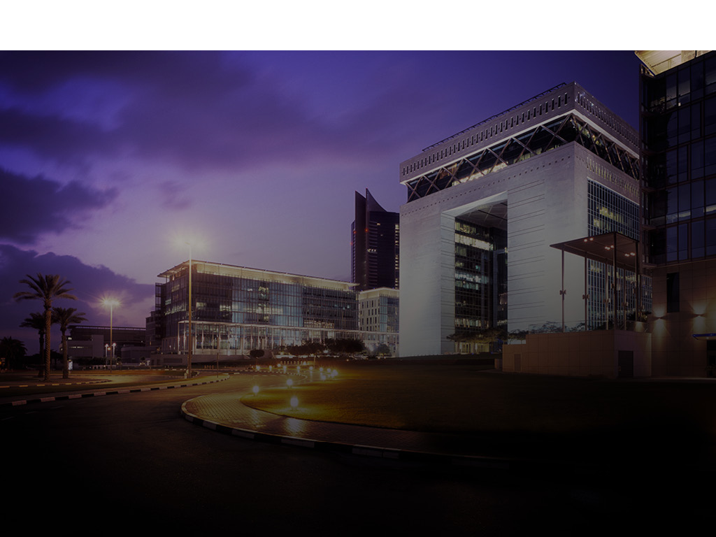
OPPORTUNITIES
BANKING AND FINANCE
Dubai is aiming to be a global
capital of Islamic industry,
economy and finance
Value of Dubai
bourses
$
89.2
BN
MARKET CAPITALISATION
Value of Dubai bourses
March 2016
DIFC COURTS
Independent judiciary for
civil and commercial disputes,
based on UK common law
1,100 REGISTERED COMPANIES
and 17,000 workforce in DIFC
Notes:
DFM and stock holidays

Slide 26
OPPORTUNITIES
BANKING AND FINANCE
FINANCIAL SECTOR'S
CONTRIBUTION TO GDP
2013
2014
2015
164
$11BN
$11.3BN
$11.7BN
M
METRO PASSENGERS
108.9m taxi passengers
91.9m public buses
passengers
14% share of public
10.9%
transport in people’s
mobility
on average of total GDP
2015
Notes:
Current (Nominal) GDP used
Exchange rate used 3.7
2015 – 11.2%
2014 – 11.1%
2013 – 10.6%

Slide 27
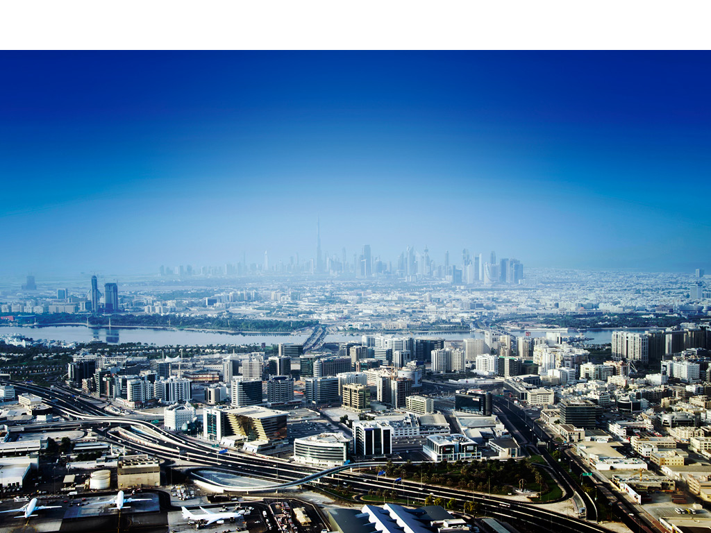
OPPORTUNITIES
TRADE HUB
19
Dubai South is the first world’s aerotropolis targeting 220M passengers
and 12M TEU of cargo
M TEU
Jebel Ali Port’s
Capacity,
to reach 22.1M TEU in 2018
Notes:
sd

Slide 28
OPPORTUNITIES
DUBAI TRADE
Dubai’s
DUBAI TRADE GROWTH 2005-2016
infrastructure
is new, modern
and growing all
the time
$132Bn
$256Bn
$338Bn
$347Bn
164
M
METRO PASSENGERS
108.9m taxi passengers
91.9m public buses
531M
passengers
14% share of public
PUBLIC TRANSPORT
transport in people’s
2008
PASSENGERS in 2014
2005
2012
2016
mobility
compared to 440m in
2015
2013 (21% increase)
2014

Slide 29
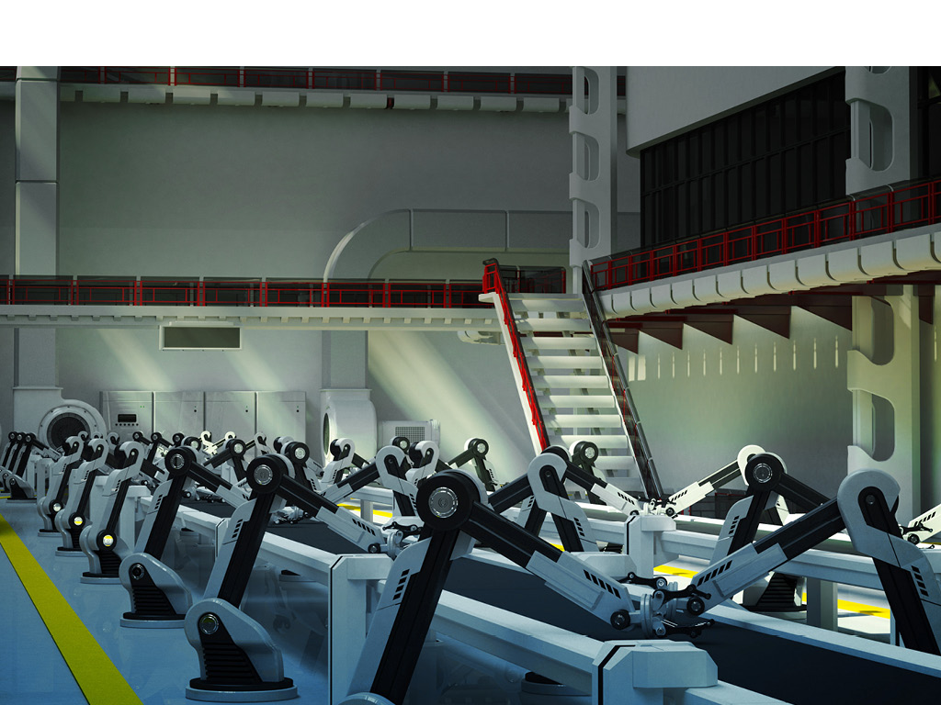
OPPORTUNITIES
MANUFACTURING
$19.04BN
Six industrial sectors are targeted for Dubai
Aerospace
Maritime
Pharmaceuticals & Medical equipment
Aluminium & Fabricated Metals
Fast Moving Consumable Goods
Machinery and Equipment
Focus on becoming a global platform for Knowledge-based, sustainable and innovative industries
Bank credit to
UAE’s Industrial sector,
190% growth
over 10 years

Slide 30
OPPORTUNITIES
MANUFACTURING
GDP GENERATED AT CONSTANT
PRICES BY MANUFACTURING
2013
2014
2015
164
$9.1BN
$9.5BN
$9.8BN
M
METRO PASSENGERS
108.9m taxi passengers
91.9m public buses
531M
passengers
14% share of public
Represents an average
PUBLIC TRANSPORT
transport in people’s
PASSENGERS in 2014
of 9.9% of total GDP
mobility
compared to 440m in
2015
2013 (21% increase)
2014
Notes:
Cannot find updated numbers for light manufacturing 9.8+9.9+9.9

Slide 31
OPPORTUNITIES
INFORMATION TECHNOLOGY
2.29
19.7M
M
Fixed lines
ACTIVE MOBILE
in ICT
$4.8 BN
SUBSCRIPTIONS
infrastructure
UAE ranked
2017
IN TECHNOLOGY
first worlwide in
IOT (Internet of Things)
mobile network
contribute to Dubai’s
coverage
economy by 2020
2017
OPEN DATA LAW
Enacted in 2015 to
improve accessibility
of data and encourage
innovation and
entrepreneurship in
smart services

Slide 32
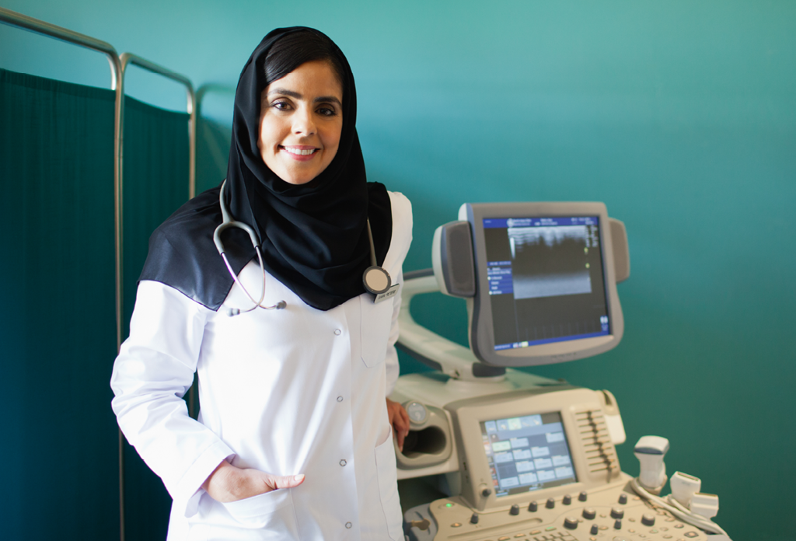
OPPORTUNITIES
HEALTHCARE
Dubai has
HIGH PRIORITY INVESTMENT
mandated
OPPORTUNITIES
extensive
in obstetrics and
healthcare
gynaecology, orthopaedics
insurance
and trauma, gastrointestinal
for all residents
emergency, rehabilitation
and long-term care
Sector value is
$17BN
expected to 60%
By 2021
value of
the UAE’S
HEALTHCARE
MARKET
in 2016
MENA Research Partners

Slide 33
OPPORTUNITIES
HEALTHCARE
Dubai’s
infrastructure
NUMBERS OF MEDICAL TOURISTS
is new, modern
and growing all
the time
135,000
2014
164
150,000
2015
M
METRO PASSENGERS
108.9m taxi passengers
175,000
2016
91.9m public buses
531M
passengers
14% share of public
PUBLIC TRANSPORT
transport in people’s
PASSENGERS in 2014
mobility
500,000
compared to 440m in
2020
2015
2013 (21% increase)
2014

Slide 34
WHY DUBAI
EDUCATION
57
HIGHER EDUCATION
5.6%
INSTITUTES
59,801
enrolments
Enrolment growth
2015/16 school year
year-on-year
74%
$272 M
PRIVATE SCHOOLS
teach entrepreneurial
SMART LEARNING
skills starting from Grade 6.
initiative launched
72% of activities focus on
in 2012 to improve
generating new ideas and
technology in schools
developing business skills
across the UAE

Slide 35
WHY DUBAI
EDUCATION
265,299
students
164
M
educated in
offering
employing
METRO PASSENGERS
173
16
16,252
108.9m taxi passengers
91.9m public buses
531M
passengers
private schools
curriculums
teachers
14% share of public
PUBLIC TRANSPORT
transport in people’s
PASSENGERS in 2014
mobility
compared to 440m in
2015
2013 (21% increase)
School year 2015 / 2016
2014

Slide 36
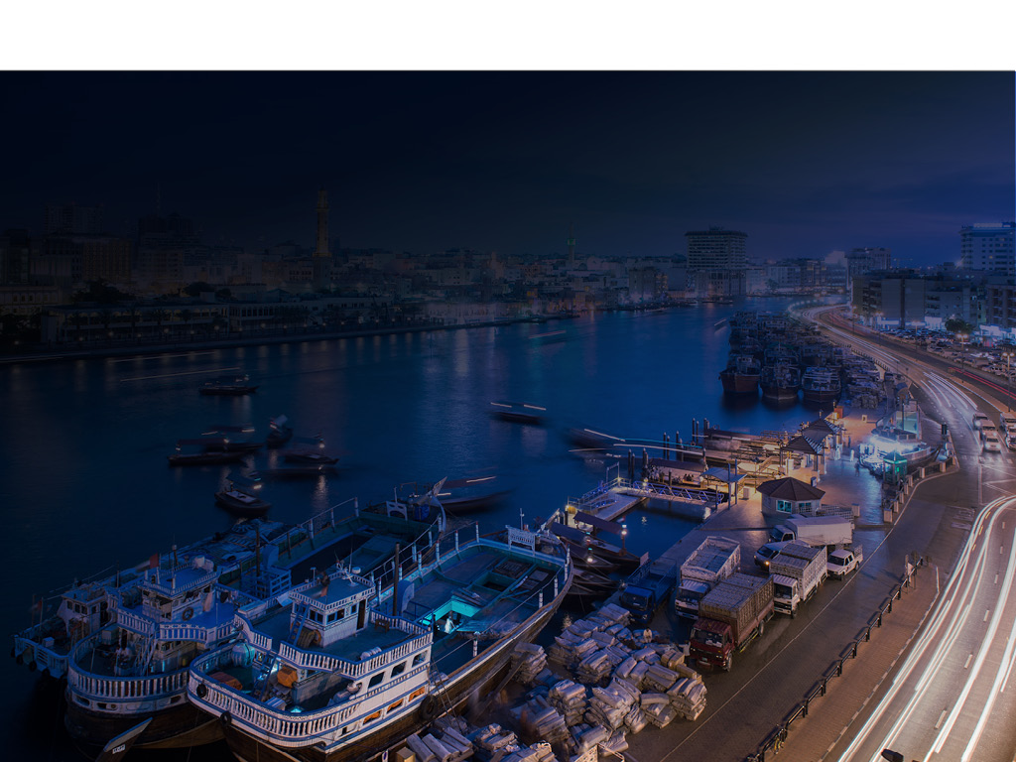
WHY DUBAI
ONSHORE LICENSING
Work with an experienced local partner
Established trade agreements
Raw materials and equipment used in manufacturing exempt from custom duties
Tax free environment
100% foreign ownership for professional services license
Benefit from double taxation treaties

Slide 37
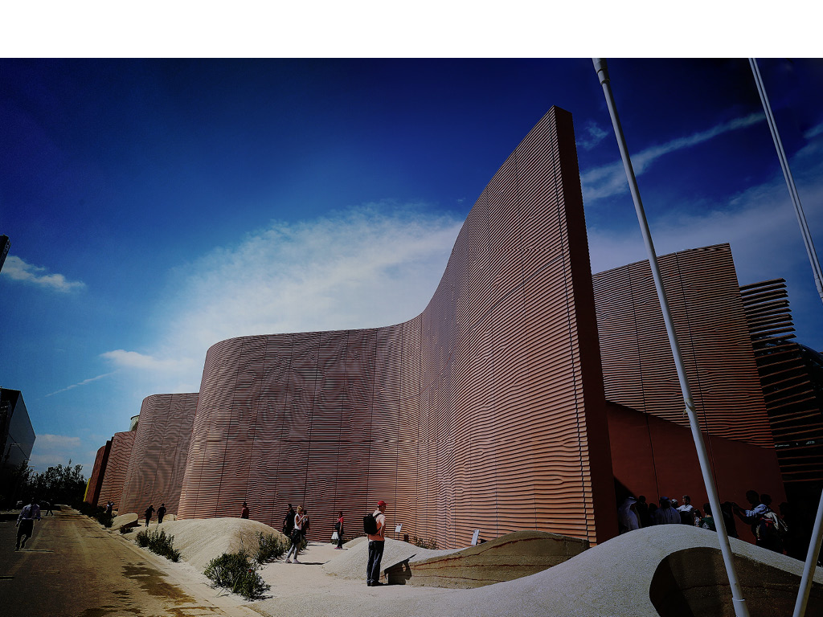
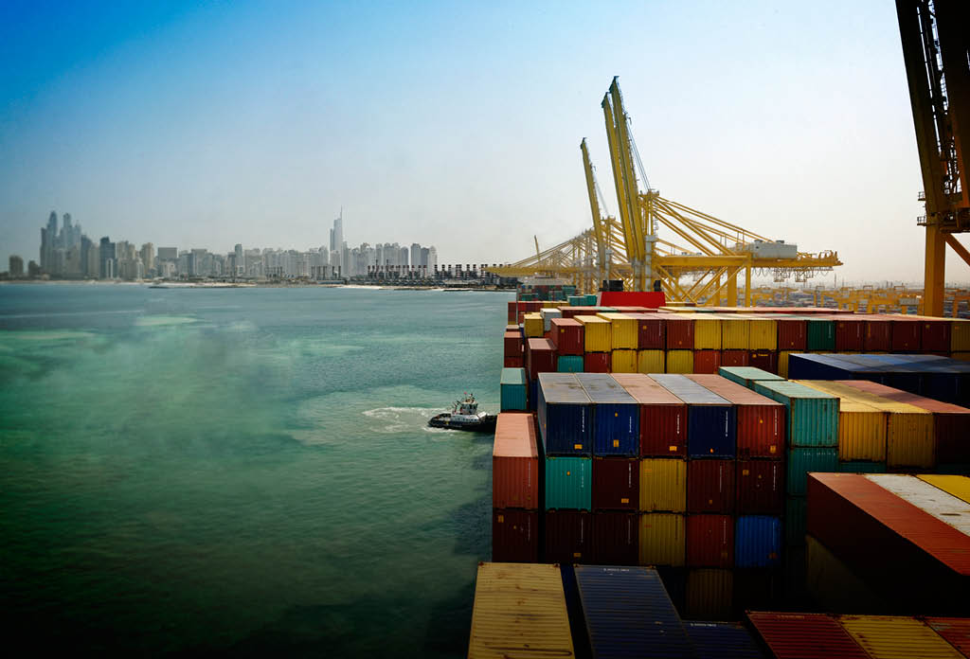
WHY DUBAI
FREEZONE LICENSING
EXPO 2020 DUBAI
THEME
20 October 2020
Connecting Minds
through 10 April 2021
Creating the
FIRST TIME
Future
World Expo to
be staged in
MEASA region
SUB-THEMES
Mobility
Sustainability
Opportunity
Tax-free: no income tax
100% foreign ownership
100% repatriation of profits
22 sector specific freezones
25
M
Visits expected to
the event, 70% to
be international

Slide 38
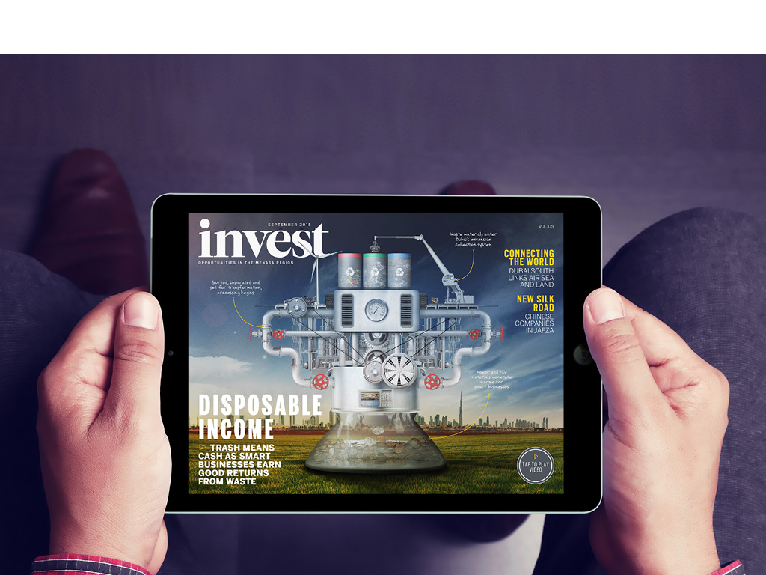
WHY DUBAI
GET IN TOUCH
www.dubaifdi.gov.ae

